Slide 1
MEKON/HOBO Introductory Tutorial
[Under Construction]

Slide 2
Primary Tutorial Goal
Introduction to modelling frameworks:
MEKON:
Models Embodying Knowledge from ONtologies
HOBO:
Hybrid models integrating OBjects and Ontologies
Covering general principles + concepts
Introducing MEKON/HOBO ClassNames
NOT covering code-level examples

Slide 3
Secondary Tutorial Goal
Introduction to Model Explorer application
GUI-based tool for MEKON/HOBO developers
Covering:
Browsing of models
Exploration of dynamic behaviour of model-instantiations
Storage/retrieval/querying of model-instantiations
Note:
Model Explorer does NOT support any kind of model-editing

Slide 4
Tutorial Pre-Conditions
Basic familiarity with:
Frames-based knowledge representation
OWL + Description Logics
Accessed MEKON project website (*)
Viewed general introductory material
Checked-out all code and resources
Built all code and resources
Optionally, via ANT build script provided
* https://code.google.com/p/mekon

Slide 5
Tutorial Format
Main Body:
Guides user through using Model Explorer to:
Browse simple demo model
Basic MEKON version
Hybrid HOBO/MEKON version
Create specific instantiations of demo model
Creating + storing “assertion” instances
Creating + executing “query” instances
Appendix:
Provides instructions on running Model Explorer with the different model-versions

Slide 6
Tutorial Format: Main Body
Actions:
A series of actions is described, to be performed via the Model Explorer (ME) application
The action descriptions come with screenshots showing either the actions being performed, or the results of the actions having occurred
Discussions:
Discussions are provided concerning the functionalities being displayed as the actions are performed
Interspersed throughout are general discussions, not specifically linked to the actions on any particular slides, but more generally applicable to various actions on previous and/or subsequent slides
Icons:
The semantics of the ME icons are summarised at the start of the tutorial
Recaps are provided throughout for specific icons as they are introduced
The semantics of specific icon-modifiers, and of modifiers for the associated text, are provided at relevant points
Note: Comprehensive help-glossaries can be obtained via the ME “Help” button

Slide 7
Browsing Basic MEKON Version of Model

Slide 8
MEKON Models
MEKON models involve the following representations:
Frames Model (FM): The FM is the core MEKON representation. All entities in a particular MEKON model, no matter their original source will be represented via entities in the FM. The FM embodies a generic frames-based representation (see next slide for more details)
External Knowledge Sources (EKS): All entities in a basic MEKON FM will be derived from one or more external sources, typically be ontologies of some kind. The MEKON framework itself has no dependency on any particular EKS format. All access of EKS and associated reasoning mechanisms is via plug-in SPIs (Service Provider Interfaces). MEKON comes with a small set of OWL-based plug-ins, implementing these SPIs, collectively known as MEKON-OWL.
Object Model (OM): Sections of the FM can also be derived from a suitable HOBO-based domain-specific OM, which will operate in tandem with the FM, with tight bindings being maintained between the two. Hence, in general, the source(s) for a particular FM entity can be external (EKS), internal (OM), or, where appropriate mappings have been provided via the configuration file, dual (EKS + OM). In general, in a HOBO/MEKON model, the vast majority of entities will have only an external source, with only a small handful having an internal source (being either internal-only sourced, or dual sourced)
Note: This section of the tutorial deals only with basic EKS-derived FMs. HOBO-based FM/OM hybrids are dealt with in the next section.

Slide 9
Frames Model Entities
The FM representation includes entities at three distinct representational levels:
Concept-Level : Representation of domain model:
CFrame: Domain concept
CNumber: Numeric-value definition (numeric-type + valid value-range)
CValue: Concept-level value-entity (CFrame or CNumber)
CSlot: Inter-concept relationships OR numerical attribute of concept
Instance-Level: Representation of specific instantiations of domain model:
IFrame: Instantiation of domain concept
INumber: Specific numeric value
IValue: Instance-level value-entity (IFrame or INumber)
ISlot: Inter-instance relationships OR numerical attribute value
Meta-Level: Representation of references to domain model entities:
MFrame: Reference to domain concept (used solely for defining value-types of CFrame-valued slots)

Slide 10
Icon Summary
Shapes (all relevant colours)
Entity Category
Entity Level
Icon Shape
Frame
Meta
Frame/Number
Concept
Frame/Number
Instance
Slot
Concept/Instance
Colours (all relevant shapes)
Entity Category
Entity, or Entity-Type, Source
Icon Colour(s)
Frame/Slot
External (EKS)
Frame/Slot
Internal (OM)
Frame/Slot
Dual (EKS + OM)
Number
ANY

Slide 11
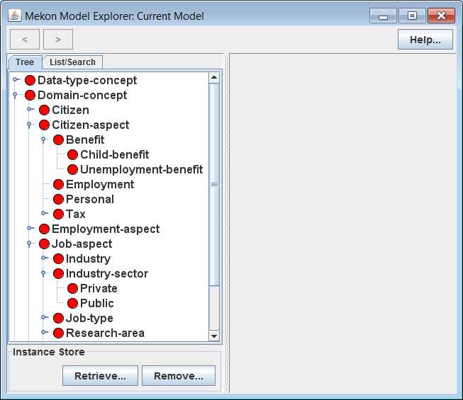
Reminder: See appendix at end of tutorial for Model Explorer invocation details
Actions:
Invoke ME with basic MEKON version of demo model
Open-up and explore tree in LH panel
Discussion:
Tree represents hierarchy of all concept-level frames, or CFrames, in model.
Model consists of this set of CFrames, together with associated sets of concept-level slots , or CSlots (not currently visible)
Icon Recap
CFrame / External source

Slide 12
MEKON Model Building
Basic MEKON FMs are derived entirely from one or more EKSs. This contrasts with hybrid HOBO/MEKON models, in which part of the FM is derived from a HOBO-based OM.
MEKON-OWL Model Builder Plug-in: In the case of the demo model, the basic version of the FM is derived from an OWL ontology, and built by the standard MEKON-OWL plug-in. This plug-in uses some fairly obvious mappings, such as:
OWL class → CFrame
Existential property restriction → CSlot
etc.
MEKON Configuration File: This file directs the entire model building process, specifying the relevant model-building plug-in(s), and any required reasoning plug-ins (such as the MEKON-OWL reasoning plug-in), and providing the required configuration information for each.
The same file is also used to specify the OM for hybrid HOBO/MEKON models, and any mappings between the OM and corresponding entities in the relevant EKSs.

Slide 13
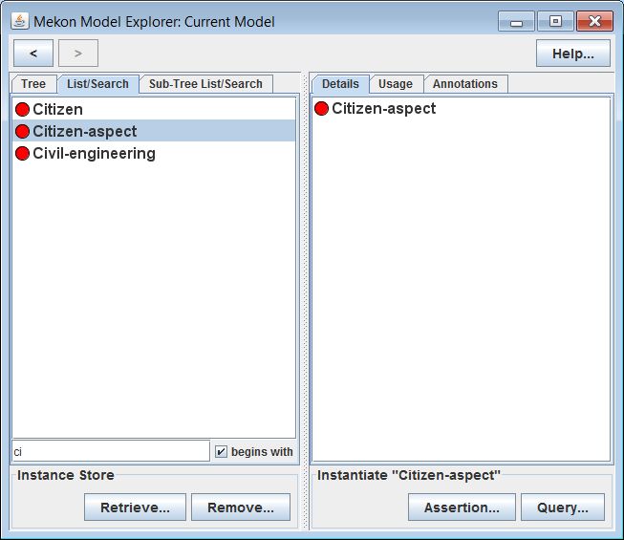
Actions:
Select various CFrames in LH panel, including some with subs
Select “List Search” tab in LH panel
Filter resulting CFrames list by typing into text-box
Select specific CFrames from resulting lists
Discussion:
Details of selected CFrames appear in RH panel (to be explained in subsequent slides)
“Sub-Tree List Search” tab appears when any CFrame with descendants is selected, containing list consisting only of descendants of selected CFrame

Slide 14
Slot Specification
Value-Types: Each CSlot provides a value-type, which defines the valid values for any ISlots created as instantiations of that CSlot. Possible value-types are:
MFrame: Defines CFrame-valued ISlot
CFrame: Defines IFrame-valued ISlot
CNumber: Defines INumber-valued ISlot
Note that a value-type specifies values at the next representation level down from itself.
Fixed Values: A CFrame can provide sets of fixed-values for instantiations of specific CSlots on either the CFrame itself or on any of it’s ancestors.
When the relevant CSlots are instantiated, along with the CFrame, any such values will be automatically added to the instantiating ISlots.
Note: Fixed-values can only be defined for CFrame-valued and INumber-valued slots. They are not applicable to IFrame-valued slots.

Slide 15
Slot Attributes
Each CSlot comes with values for the following attributes:
Cardinality: Specified via CCardinality enum, which represents a notion of cardinality that incorporates both single/multi-valuedness and value-type repeatability. Options are:
SINGLE_VALUED: Single-valued
UNIQUE_TYPES: Multi-valued / Value-types cannot duplicate or subsume one another
REPEATABLE_TYPES: Multi-valued / Any combination of legal values permitted
Editability: Specified via CEditability enum, which represents editability from the client perspective of slot instantiations, for both assertion and query instances (see later slides for details of assertion and query instantiations). Options are:
DEFAULT: Concrete-only-editable on assertions, fully-editable on queries
QUERY_ONLY: Non-editable on assertions, fully-editable on queries
FULL: Fully-editable on both assertions and queries
NONE: Non-editable on both assertions and queries
A concrete-only-editable slot is one that can only be given actual concrete values, whereas a fully-editable one can be given either concrete or abstract values (which, depending on the slot-value-type, will include disjunctions or numeric ranges – see next section for details).
Note: The DEFAULT option can be overridden by the OM or potentially by an EKS-specific model builder plug-in. The MEKON-OWL plug-in allows overriding on a per-property basis.
Active: Boolean attribute that enables applicable slots to be bound to fields on OM classes, but for instantiations of such slots (and fields) to be activated only as and when required

Slide 16
Slot Modifier Summary
Slot Text Modifiers
Attribute
Value
Additional Condition
Modifier
CCardinality
SINGLE_VALUED
[x]
CCardinality
UNIQUE_TYPES
[x,y,z]
CCardinality
REPEATABLE_TYPES
Multiple Available Types
[x,y,y]
CCardinality
REPEATABLE_TYPES
Single Available Type
[x,x,x]
Concept-Level Slot Icon Modifiers *
Attribute
Value
Modifier
* The semantics of these modifiers only apply to CSlots, as displayed in the main model window. However a couple of identical modifiers are used in the instantiation windows to represent similar, but non-identical, attributes of ISlots (see later section for details)
CEditability
FULL
CEditability
QUERY_ONLY
CEditability
NONE
active
FALSE
Note:
active=FALSE ➔ CEditability=NONE
No modifiers ➔ CEditability=DEFAULT, active=TRUE

Slide 17
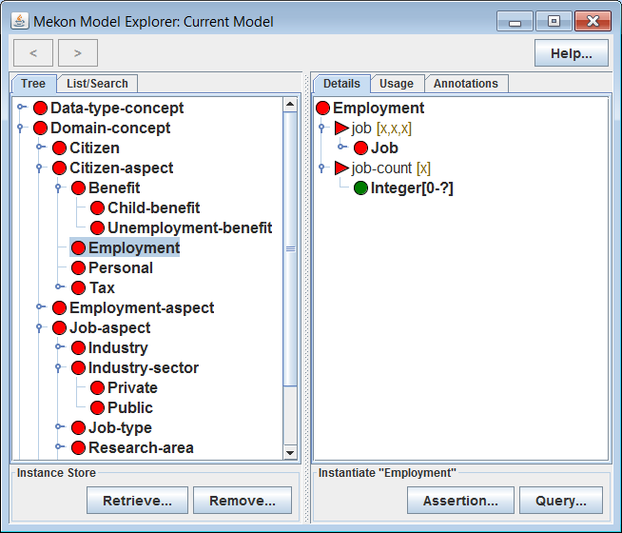
Actions:
Select Employment CFrame in LH panel
Discussion:
Details of Employment appear in RH panel, including details of two attached slots:
job: IFrame-valued slot / values must be instantiations of the Job CFrame
job-count: Integer-valued slot / value-type is a CNumber, specifying valid INumber values
Icon Recap
CSlot / External source
CNumber / Source(s) as for parent slot
Slot Text Modifier Recap
[x]
CCardinality=SINGLE_VALUED
[x,x,x]
CCardinality=REPEATABLE_TYPES / Single Available Type

Slide 18
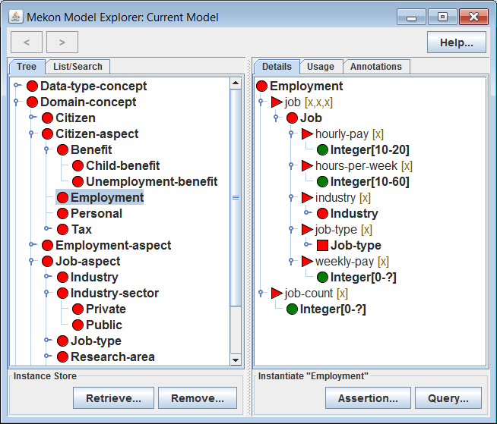
Actions:
Recursively expand section of tree under Job CFrame that represents value-type of job slot in RH panel
Discussion:
Details of Job, along with all other CFrames representing slot value-types, are recursively displayed in RH panel. Including details of both slots and descendant CFrames
Value-type of jobType slot is a meta-level frame, or MFrame, rather than a CFrame. Hence the values for that slot will be CFrames rather than IFrames
Icon Recap
MFrame / External source

Slide 19
Model Instantiations
A specific model-instantiation is represented via a network of IFrames and ISlots, with each representing a particular instantiation of a particular CFrame or CSlot.
Instantiation Initialisation: When an IFrame is constructed to represent an instantiation of a particular CFrame, it is initialised as follows:
All CSlots on the CFrame, and on any ancestor CFrames, are instantiated as ISlots, and attached to the IFrame. Where there is more than one such CSlot for a particular property, then a single ISlot is created whose value-type is the intersection of the value-types of all contributing CSlots
All fixed-values on the CFrame, and on any ancestor CFrames, are added to the relevant ISlots

Slide 20
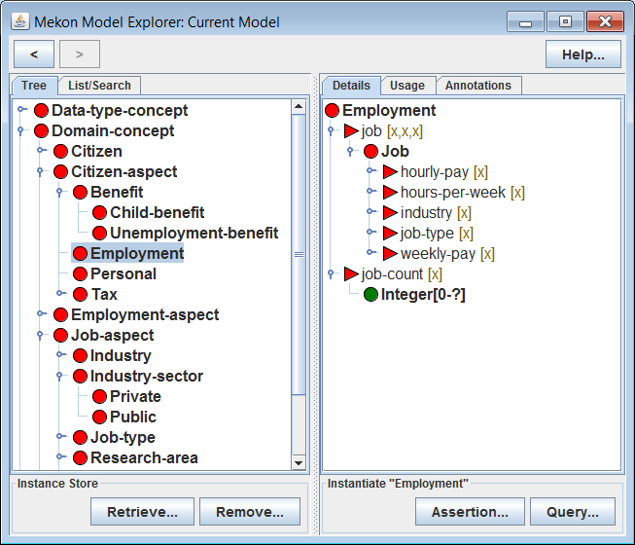
Actions:
Select CFrames in the RH panel to update selection in LH panel (and hence to update displayed details in RH panel)
Navigate backwards and forwards through previous selections using “<“ and “>” arrows in top left of GUI

Slide 21
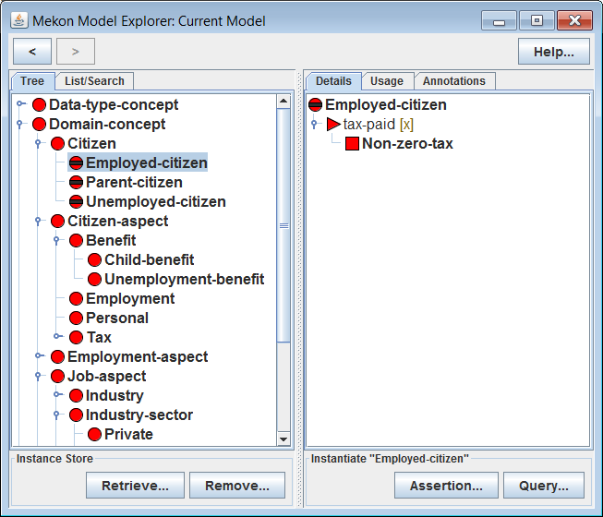
Actions:
Select Employed-citizen in LH panel
Discussion:
Employed-citizen is a hidden CFrame, which means that it cannot be instantiated, though it can play a role in the automatic updating of instantiations
If an IFrame instantiating Citizen is inferred (*) to be an instance of Employed-citizen, then the value-type of the tax-paid slot on that IFrame will be automatically updated, from the default value, Tax, as provided by Citizen, to the more specific Non-zero-tax, as provided by Employed-citizen
* See subsequent slides for further explanation of IFrame updating via OWL-based reasoning
Frame Icon Modifiers
CFrame is hidden frame
MFrame is hidden frame

Slide 22
Dynamic Instantiation Updating
As the state of an instantiation (i.e. an IFrame/ISlot network) is updated by the client, additional dynamic updates may be automatically provided by appropriate reasoning plug-ins. In the case of the demo-model, this means the MEKON-OWL reasoning plug-in (see next slide). It is possible however that a range of plug-ins could be implemented for different EKS, with possibly multiple plug-ins operating on a single FM, with each covering a different section of the model.
The reasoning plug-ins can provide the following types of dynamic instantiation updating:
Slot-set updating: Adding/removing ISlots for particular IFrames
Slot value-type updating: Updating value-types for particular ISlots
Slot value updating: Adding/removing values for particular ISlots
Reasoning plug-ins can also provide the following additional information (which is actually meta-data about the instantiation in it’s current state, rather than actual instantiation updates):
Inferred-types: Set of additional CFrames of which instantiation can be inferred to be an instance (i.e. in addition to the CFrame that was originally instantiated)
Suggested-types: CFrames of which instantiation can be inferred to be a potential instance (via some form of partial definition-match)
Whenever an update is made to an instantiation by the client, the relevant reasoning plug-in will be invoked for each possible sub-network, working backwards from the particular ISlot whose value(s) were updated, with any resulting updates being applied to the instantiation, as the operation proceeds

Slide 23
MEKON-OWL Reasoning Plug-in
The MEKON-OWL reasoning plug-in implements the automatic instantiation updating process, acting on a particular IFrame/ISlot network, or sub-network, as follows:
An OWL construct is created to represent the current state of the network, or the relevant parts of it. This will be either:
OWL class-expression: If network is a tree
Network of OWL individuals: If network contains convergences or cycles
The DL reasoner is applied to the construct to determine the following sets of CFrames:
Inferred-types: From super-classes, or types (depending on type of construct)
Suggested-types: From sub-classes (only obtained if construct is individuals-network)
The sets of CSlots and fixed-values associated with the inferred-types are used to dynamically update the root-IFrame, as follows:
Slot-set updating: Based on CSlots
Slot value-type updating: Based on CSlots
Slot value updating: Based on fixed-values
The plug-in can be configured, via the relevant section of the configuration file, so that the OWL constructs that it generates and classifies will embody specific slot-semantics, with the options being:
OPEN_WORLD: Slot-value sets represented via sets of existential restrictions
CLOSED_WORLD: Slot-value sets represented via sets of existential restrictions, plus single universal “closure” restrictions, whose fillers are disjunctions of all slot-value representations
Note: These slot-semantics are configurable on a per-property basis.

Slide 24
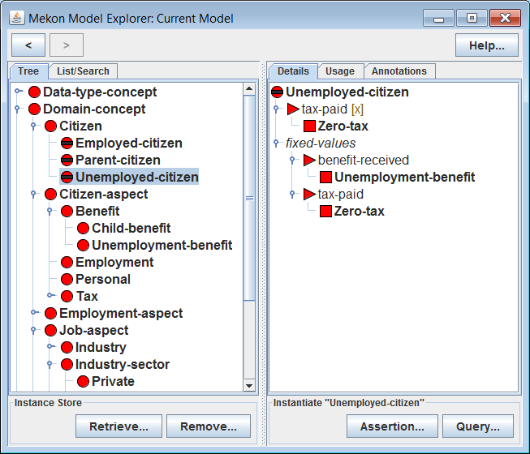
Actions:
Select Unemployed-citizen in LH panel
Discussion:
Unemployed-citizen, similarly to Employed-citizen, provides a specialisation of the value-type for the tax-paid slot
It also provides fixed-values for both that slot and the benefit-received slot, representing values that will be assigned to the relevant ISlots whenever an IFrame is classified accordingly
Hence if an IFrame instantiating Citizen is classified as an instance of Unemployed-citizen, then not only will the tax-paid ISlot be given a specialised value-type of Zero-tax, it will also be assigned a value of Zero-tax. Similarly the benefit-received ISlot will be assigned a value of Unemployment-benefit

Slide 25
Browsing Hybrid HOBO/MEKON Version of Model

Slide 26
HOBO/MEKON Hybrid Models
The HOBO framework provides the following:
Generic modelling classes and interfaces for building domain-specific OMs
Mechanisms for binding HOBO OMs to MEKON FMs
OM Modelling: The main entities from which the domain-specific OMs are built are:
DObject: Interface implemented by all OM classes
DField: Class used to represent all OM fields (abstract base class with concrete extensions DCell and DArray)
OM ←→ FM Bindings: Every OM entity will be bound to a corresponding FM entity:
DObject-derived-class: ←→ CFrame
DField-typed-variable: ←→ CSlot
The instantiations of these OM entities will be bound to, respectively, IFrame and ISlot
The FM entity to which an OM entity is bound will be either:
EKS-derived: If suitable mapping specified via HOBO configuration file
Specifically generated: Otherwise
The bindings ensure that any relevant operations initiated in either representation will be reflected by the occurrence of corresponding operations in the other.

Slide 27
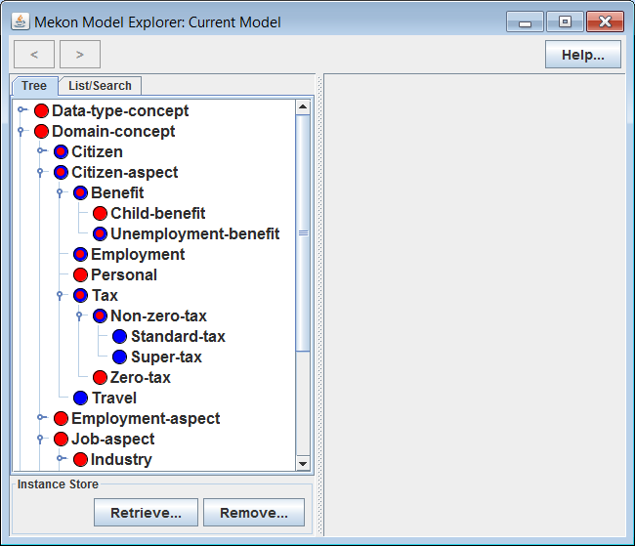
Reminder: See appendix at end of tutorial for Model Explorer invocation details
Actions:
Invoke ME with hybrid HOBO/MEKON version of demo model, whilst leaving running previous invocation of ME, with basic MEKON version of model, for comparison purposes
Open-up and explore CFrame tree in LH panel
Discussion:
The blue splurges now visible indicate that certain “key” CFrames are bound to OM classes
Some, such as Citizen, have dual sources – i.e. OM class and OWL class
Others, such as Super-tax, have only an internal source - i.e. an OM class
Other CFrames , such as Zero-tax have only external sources, meaning that they are not represented at all in the OM
Note that those CFrames with external or dual sources also appear in the basic MEKON version of the model, whereas those with only internal sources do not
Icon Recap
CFrame / Internal source
CFrame / Dual sources

Slide 28
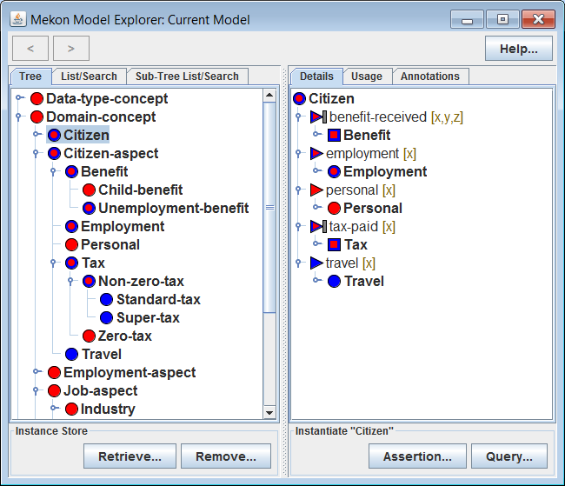
Actions:
Select Citizen in LH panel
Discussion:
The CSlots and value-types that appear are also coloured by source(s)
The benefit-received CSlot has been specified (by the OM) as being a QUERY_ONLY editable slot. Hence values for instantiations of this slot that appear on assertions will always be derived automatically from those of other slots
Icon Recap
MFrame / Dual sources
Slot Icon Modifier Recap
CSlot / Internal source
CEditability=QUERY_ONLY
CSlot / Dual sources

Slide 29
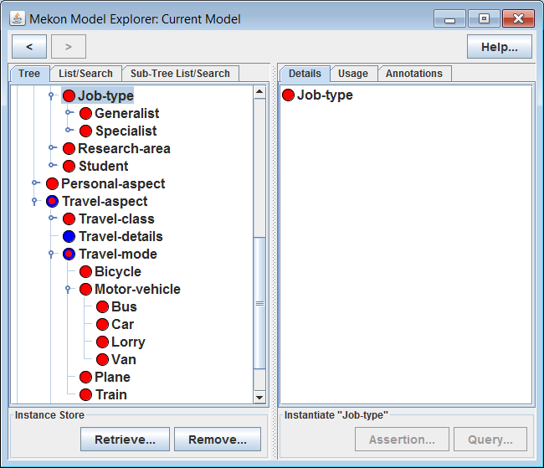
Actions:
Expand trees under both Job-type and Travel-mode
Discussion:
Note that the contents of both trees are derived mainly from external sources only, with the only exception being Travel-mode itself
This is indicative of what more realistic models look like – i.e. mainly constituted by large externally-derived hierarchies (much larger than in the demo model), with only a relative handful of core concepts being represented in the OM
When a CFrame with only an external source is instantiated, the nature of the corresponding OM instantiation is dependent on the presence or otherwise of internally-sourced ancestors.
For instance, Bus will be represented in the OM via the TravelMode class, whereas Accountant, having no internally-sourced ancestors, will be represented via a default implementation of DObject

Slide 30
Creating + Storing Assertion Instances

Slide 31
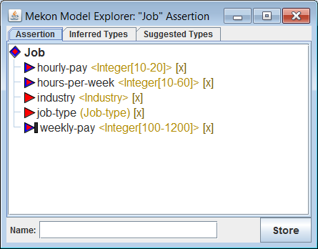
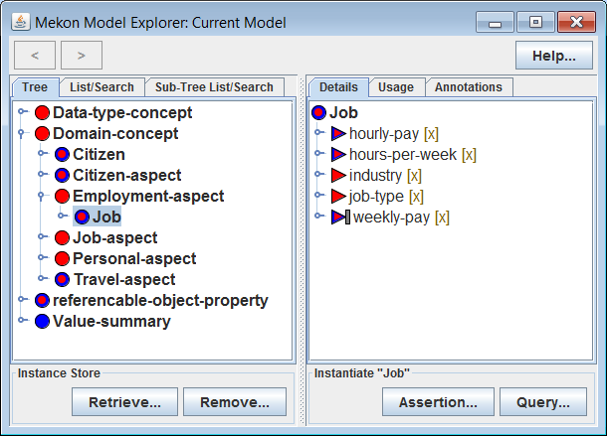
Actions:
Continue with hybrid version of demo model
Select Job in LH panel
Click on “Assertion…” button in “Instantiate” area at bottom of RH panel
Discussion:
This window shows an IFrame instantiating Job
This is an assertion, rather than query, instance (see next slide for details)
Icon Recap
IFrame / Dual-sourced type
Note: ISlots are distinguished from CSlots by context alone
See subsequent slides for details of instance-level slot modifiers…
ISlot / Externally-sourced type
ISlot / Dual-sourced type

Slide 32
Assertion and Query Instances
Instances: An instance is an IFrame/ISlot network representing a particular instantiation of the FM. In general, such a network can constitute a general directed graph, which may include convergences and cycles. However, instances created via the ME are restricted to being tree-like in structure.
Assertions and Queries: An assertion instance represents a specific concrete entity, whereas a query instance provides an abstract specification of a set of such entities. Sets of assertions can be stored in an instance store, with specific subsets being retrieved via suitably constructed queries (see later for details). In general assertions and queries may differ in the following attributes:
Abstract slot-values (*): By default, abstract slot-values (see next slide) are allowed for queries but not for assertions.
Editable/non-editable slots (*): Generally slots that are specified as non-editable on assertions, since their values will be automatically derived by the model(**), will be specified as editable on queries, since querying for the values of such slots will still make sense.
Slot value-inferencing: Values for certain slots on assertions may be automatically derived by the model(**), whereas, in general, no such inference will occur for queries, since the automatic inference in the assertions will make such inference in queries redundant.
* Both subsumed by general notion of editability, as represented by IEditability (see next slide)
** Derived via either EKS-based reasoning or OM-based processing
Note: For each of these attributes, other than EKS-based value-inferencing, the default/normal behaviours as described, can be overridden (and in each case it can make sense to do so) for specific slots, by either the OM or, for MEKON-OWL derived models, via the configuration file.

Slide 33
Concrete and Abstract Values + Instance Slot Editability
Concrete Values: A concrete slot-value is one of:
Atomic-CFrame: CFrame of standard type, with specific identifier
Atomic-typed-IFrame: IFrame whose type is an atomic-CFrame
Definite-INumber: INumber that represents a specific concrete value
Abstract Values: An abstract slot-value is one of:
Disjunction-CFrame: Special CFrame that represents a disjunction of simple-CFrames
Disjunction-typed-IFrame: IFrame whose type is a disjunction-CFrame
Indefinite-INumber: INumber that represents a value-range, rather than a specific value
Instance Slot Editability: The editability from the perspective of the client of an ISlot on an instance (assertion or query) is defined via the IEditability enum. Options are:
FULL: Slot can be given both concrete and abstract values by the client
CONCRETE_ONLY: Slot can only be given concrete values by the client
NONE: Slot is not editable by the client
As explained earlier, the editability of an ISlot is determined by the CEditability value associated with the CSlot of which it is an instantiation. Note that certain CEditability values will specify different IEditability values for assertion and query instantiations (e.g. a CEditability value of DEFAULT specifies IEditability values of FULL for queries and CONCRETE_ONLY for assertions)

Slide 34
Instance-Level Slot Icon Modifiers
IEditability=FULL
IEditability=NONE
Note: As discussed earlier, identical modifiers are used in the main model window to represent the CEditability values of CSlots
Instance-Level Slot Text Modifiers
<VALUE-TYPE>
IFrame/INumber-valued slot with specified value-type
(VALUE-TYPE)
CFrame-valued slot with specified value-type
Note: Value-types are only displayed in this way for ISlots in instantiation windows, not for CSlots in model window

Slide 35
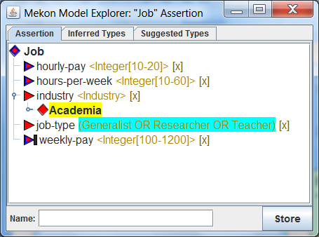
Actions:
Left-click on the industry” slot node
Select Academia in the dialog that appears (using either of the tabs provided: “tree” or “list/search” )
Discussion:
The Academia value that appears under the industry slot represents an IFrame that has been created and set as the value for that slot
Note that the value-type for the job-type slot has been automatically updated from the default Job-type to an appropriate disjunction-MFrame (i.e. an MFrame corresponding to a disjunction-CFrame)
This value-type update is due to OWL-based inference acting on the entered value, and mediated by the MEKON-OWL reasoning plug-in
Displaying Effects of Latest Action
User Input
Model response (by EKS or OM)
Note: These colourings are part of the screenshots, being provided by the MEKON GUI

Slide 36
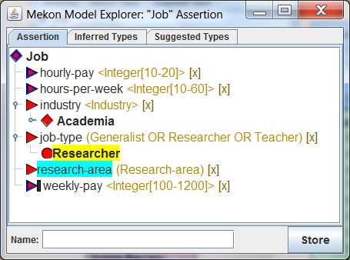
Actions:
Add a value of Researcher, for the job-type slot (by left-clicking on the relevant node, as before)
Discussion:
Note that a new research-area slot appears, which is due to further OWL-based inference, invoked in response to this latest action
Displaying Effects of Latest Action: User Input
VALUE-LABEL
Value added
SLOT-NAME
VALUE-TYPE […]
Value(s) removed
Displaying Effects of Latest Action: Model Response
VALUE-LABEL
Value added, or non-visible descendants removed
SLOT-NAME
VALUE-TYPE […]
Value(s) removed, or non-visible descendants updated
SLOT-NAME
VALUE-TYPE
[…]
Value-type updated

Slide 37
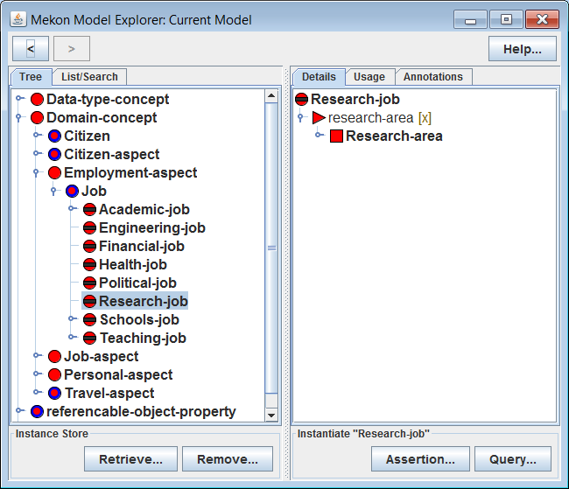
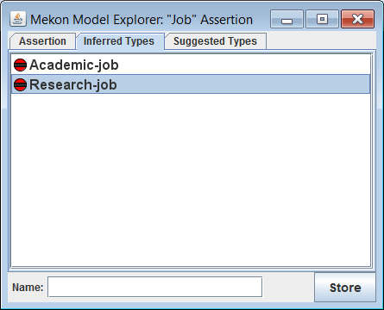
Actions:
Select the “Inferred Types” tab in the assertion window
Select in turn each of the CFrames that appear in that tab, which will cause corresponding selections to be made in the main window
Discussion:
The displayed CFrames are the currently inferred-types of the assertion
The details displayed in the main window show the roles that these inferred-types played in the previously witnessed dynamic updates:
Academic-job provided the specialisation for the pre-existing job-type slot (as originally provided by Job)
Research-job provided the definition for the dynamically created research-area slot

Slide 38
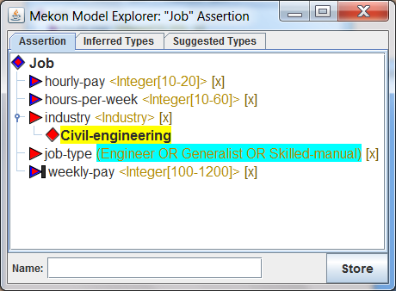
Actions:
Try adding and removing various values for the industry slot in the following ways:
Left-click on slot node to add new value (which, since slot is SINGLE_VALUED, will replace previous value)
Right-click on value node to remove relevant value
Right-click on slot node to clear all values for the slot (which, for SINGLE_VALUED slots will always amount to the same thing)
Note appropriate updates occurring to value-type of job-type slot

Slide 39
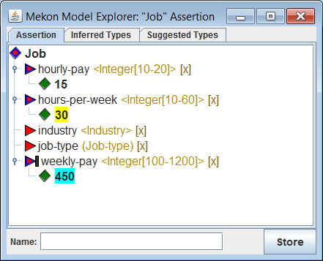
Actions:
Set values for hours-per-week and hourly-pay slots (left-clicking on nodes for numeric slots will produce appropriate input dialogs)
Discussion:
Note that the weekly-pay slot has now been automatically assigned an appropriate value
This assignment was performed by the OM, rather than via OWL-based reasoning, which does not support such numeric calculations (if you perform the equivalent actions on the basic OM-free MEKON version of the model, then no such automatic updating will occur)
The OM performs the updates in response to the firing of listeners it attached to the relevant ISlots
Icon Recap
INumber / Type source(s) as for parent slot

Slide 40
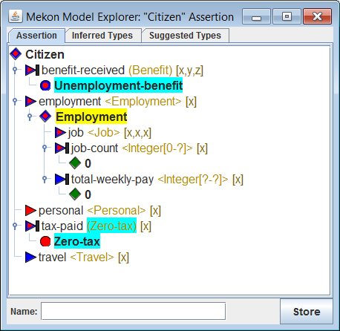
Actions:
Instantiate Citizen assertion
Left-click employment slot node
Expand resulting Employment value
Discussion:
Since there is only one possible value-type for employment, rather than a hierarchy of possible types, a value of the relevant type appears automatically, without any need for a value-type selection dialog
The benefit-received and tax-paid slots are automatically assigned values, whilst the latter also has it’s value-type updated. This is all a result of OWL-based reasoning, driven by the fact that the newly assigned value for the employment slot currently has no value in it’s job slot (see next slide for details)

Slide 41
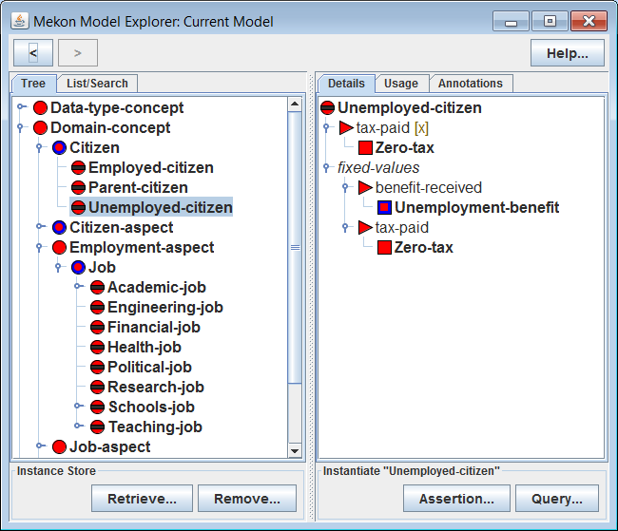
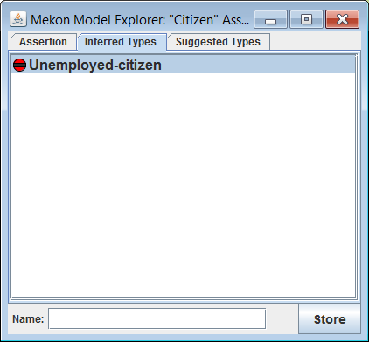
Actions:
Select the “Inferred Types” tab in the assertion window
Select Unemployed-citizen from that tab, causing corresponding selection in the main window
Discussion:
The inference that our assertion had the type Unemployed-citizen was dependent on:
A suitable definition for the relevant OWL class
The specification in the configuration file of CLOSED_WORLD semantics for job. resulting in the generation of appropriate OWL constructs for classification
It can be seen from the details of Unemployed-citizen how the automatic updates that occurred were prompted by (1) the tax-paid slot definition and (2) the fixed values for benefit-received and tax-paid

Slide 42
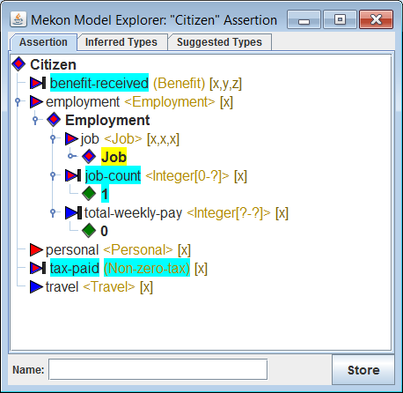
Actions:
Add a value for the job slot on the Employment value that you’ve just added (again, via a single left-click, since only one possible value-type)
Discussion:
The previous updates are reversed, since Unemployed-citizen is no longer an inferred type
However, a new inference of Employed-citizen is now made (as can be seen from the inferred-types tab), causing the value-type for the tax-paid slot to be specialised to Non-zero-tax
The job-count slot, which was originally set to 0 has new been updated, by the OM, to 1. This type of update, requiring some form of second order processing, cannot be achieved via standard OWL-based reasoning, but is a trivial task for the OM

Slide 43
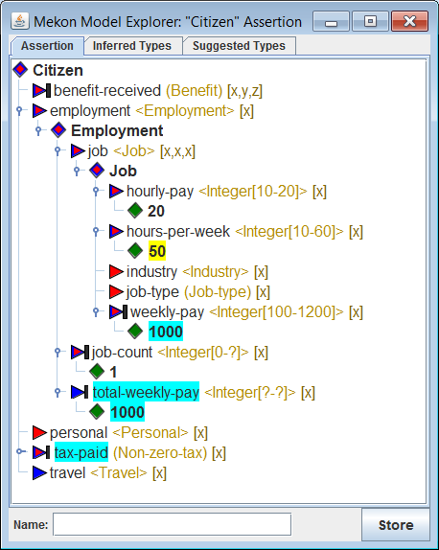
Actions:
Fill in values for the hourly-pay and hours-per-week slots on the Job value
Discussion:
Not only does the OM automatically update the weekly-pay slot on Job, as in the previous example, it also updates the total-weekly-pay slot on the parent Employment frame
The OM also uses the resulting value to set a value for the tax-paid slot on Citizen (total pay of 1000 or more per-week, Super-tax, otherwise, Standard-tax). Hence this slot can have automatic values set as a result of either OWL-based reasoning (as demonstrated earlier when it was set to Zero-tax) or of procedural processing by the OM (as here)

Slide 44
Instance Stores + Instance Matchers
Instance Store (IS): An IS will provide persistent storage for collections of assertion instantiations for a particular MEKON FM. An IS can be queried over via specifically constructed query instantiations of the same FM.
The assertions are stored by the IS using MEKONs own XML-based instance-representation format. (Note: This format is also available to MEKON clients, along with an appropriate parser and renderer, enabling the serialisation of both assertions and queries, for purposes such as client/server communication.)
Instance Matcher (IM): Queries over the IS are handled by specific IM plug-ins. An IM plug-in will generally operate over a specific type of EKS, with possibly multiple IMs being attached to an FM (similarly to the way that an FM may have multiple reasoning plug-ins attached).
MEKON-OWL Instance Matcher Plug-in: MEKON-OWL provides a default IM plug-in that, on start-up, renders the relevant assertions from the IS, or their relevant parts, as networks of OWL individuals, and adds them to the in-memory version of the OWL ontology. It then uses a standard DL reasoner to execute submitted queries, which it renders as appropriate OWL class-expressions. The slot-semantics that are used in rendering both the individual-networks representing the stored assertions, and the class-expressions representing the queries, are configurable in similar fashion as for the MEKON-OWL reasoning plug-in (see earlier).

Slide 45
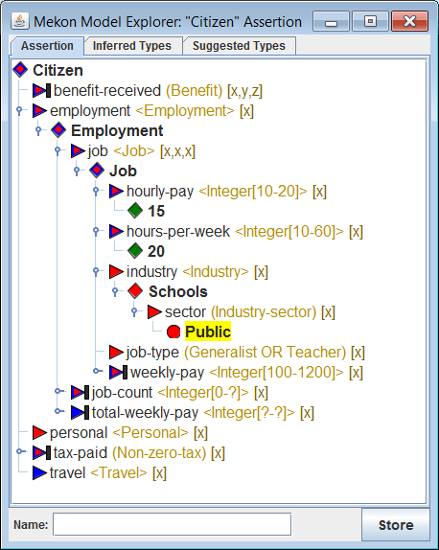
Actions:
Create and populate various different Citizen assertions
For each assertion:
Fill in the “Name” field at bottom left of assertion window
Click “Store…” button at bottom right of assertion window
Note :
Assertions do not need to have all slots filled before they can be stored
An assertion, once stored, can subsequently be modified and re-stored under a different name
Discussion:
Each storage action will cause appropriate updates to each of the following:
Persistent version of IS
In-memory version of IS
In-memory version of OWL ontology

Slide 46
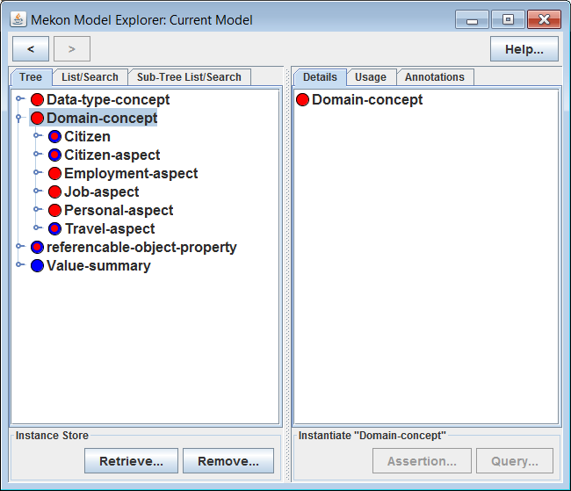

Actions:
Click “Retrieve…” in “Instance Store” area at bottom of LH panel of main window
Enter the name of a previously stored assertion in the dialog box that appears, thus causing that assertion to be re-displayed in a new assertion window (wherein it can be edited and re-stored, if required)

Slide 47
Actions:
Click “Remove…” in “Instance Store” area at bottom of LH panel of main window
Enter the name of a previously stored assertion in the dialog box that appears, then click “Ok” to the resulting confirmation prompt
Discussion:
The removal action will cause appropriate updates to each of the following:
Persistent version of IS
In-memory version of IS
In-memory version of OWL ontology

Slide 48
Creating + Executing Query Instances

Slide 49
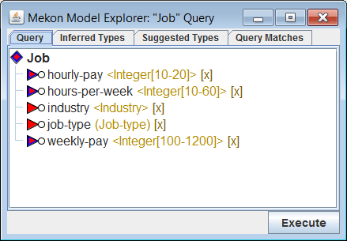
Actions:
Continue with hybrid version of demo model
Select Job in LH panel
Click on “Query…” button in “Instantiate” area at bottom of RH panel
Manually expand tree that appears in new window
Discussion:
This window shows an IFrame instantiating Job as a query, rather than assertion
See earlier discussion regarding differences between queries and assertions, and subsequent slides for further discussion and specific examples
Note that the “Store” button has been replaced by an “Execute” button, and that there is now an additional “Query Matches” tab
Slot Icon Modifier Recap:
IEditability=FULL

Slide 50
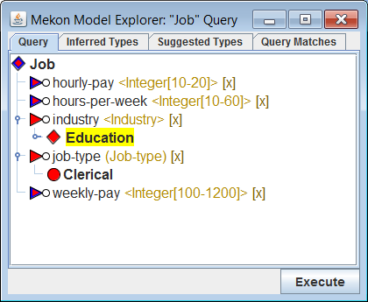
Actions:
Add value of Clerical to job-type slot
Add value of type Education to industry slot
Discussion:
Remember that job-type is CFrame-valued, whilst industry is IFrame-valued (as denoted by the respective value-type displays)
Hence, Education is the type of the value that you’ve just set for the industry slot, whilst Clerical is the actual value for the job-type slot
Note that the Education-typed IFrame has a sector slot attached, as defined via an appropriate CSlot attached to the CFrame
Note: So far, everything in this query example would work identically for an assertion

Slide 51
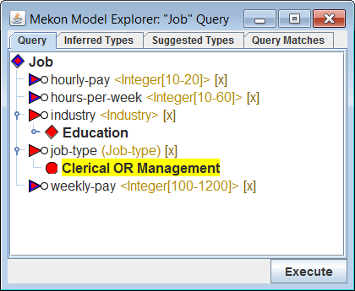
Actions:
Left-click on the value that you’ve just added for the job-type slot, i.e. the value Clerical
From the selection window that now appears, select Management
Discussion:
This causes Management to be added as an additional disjunct to the value of the job-type slot
Hence, this value is now a disjuntion-CFrame whose disjuncts are the individual CFrames for Clerical and Management
Note: As mentioned earlier, abstract slot values, including disjunction-CFrames (as shown here), as well as disjunction-typed IFrames and indefinite numeric values (see subsequent slides) are specific to queries, and hence cannot be created for assertions, other than for specifically excepted slots

Slide 52
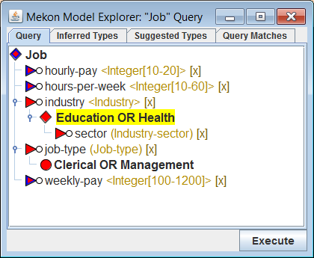
Actions:
Left-click on the value that you previously added for the industry slot, i.e. the value of type Education
From the selection window that now appears select Health
Discussion:
Since industry is an IFrame-valued slot it is the type of the value to which the disjunct is added, and which now becomes a disjuntion-CFrame (in contrast to the CFrame-valued job-type slot where the disjunct was added to the value itself)
Note that the sector slot remains after the extra disjunct has been added to the type. This is because both Education and Health provide definitions for this slot, which is therefore also defined for the disjunction of the two

Slide 53
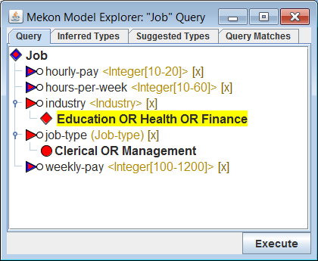
Actions:
Add a third disjunct, Finance, to the type of the value in the industry slot
Discussion:
The sector slot now disappears from the relevant value. This is because Finance does not provide any definition for this slot, and hence the slot is not defined for the new disjunction
In general, a slot will appear on a disjunction-typed IFrame if and only if it is defined for each individual disjunct, either directly on the relevant CFrame itself, or indirectly via an ancestor CFrame (in the latter case, such an ancestor may be common to multiple disjuncts). Where the definition of such a slot is derived from more than one CFrames, the value-type will be taken to be the intersection of all relevant value-types

Slide 54
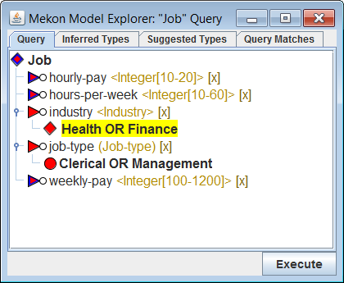
Actions:
Right-click on the current value of the industry slot, i.e. the value of type Education OR Health OR Finance
From the selection window that now appears select Education
Discussion:
The selected value is removed from the value type disjuntion
The sector slot is still absent, since Finance is still one of the value type disjuncts. However if you now also remove Finance from the value type then the slot will reappear

Slide 55
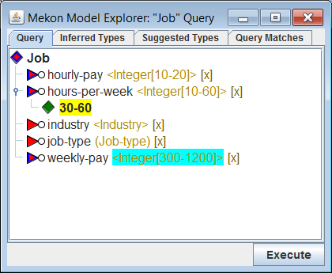
Actions:
Click on hours-per-week slot node
From general numeric-value entry window that now appears, try entering a value (value-entry options are: exact-value, range, min-only or max-only)
Repeat operation a few times, trying each value-entry options
Discussion:
Apart from exact-value, all value-entry options involve indefinite numeric-values, which along with disjunction-CFrames and disjunction-typed IFrames are abstract values, and hence by default, are specific to queries
Note that even when you use the min-only or max-only options, the resulting indefinite values always have both a min and max component. This is because the hours-per-week slot defines its own min and max values, which will always act as absolute limits for that slot

Slide 56
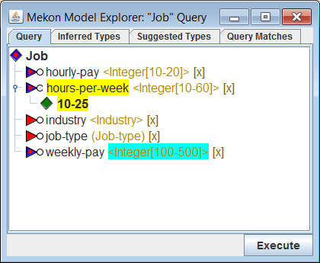
Actions:
Try entering various different exact and indefinite values for hours-per-week slot
Discussion:
Note that as the hours-per-week value is updated, the value-type of weekly-pay is updated accordingly, with min and max values being the products of those of hours-per-week and hourly-pay
As in the assertion case, the behaviour that ensues from setting hours-per-week values is governed by the OM. Note however that, in the assertion case it was the slot value that was being updated, rather than the value-type, as here (see next slide for further discussion)

Slide 57
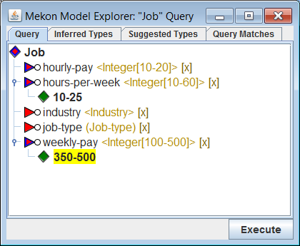
Actions:
Try entering value for weekly-pay slot
Discussion:
The fact that you can do this illustrates one of the differences between queries and assertions, namely that dependent slots, such as weekly-pay, are editable for queries, but not for assertions
This allows the formulation of queries such as the one shown
The reason that for queries, dynamic inference is restricted to value-types, rather than actual values, is that inferred values would not only be redundant in query execution, but may also lead to increased execution time.
Conversely, since dependent slots are now editable, the dynamic updating of their value-types becomes highly desirable from the point-of-view of constraining user-input

Slide 58
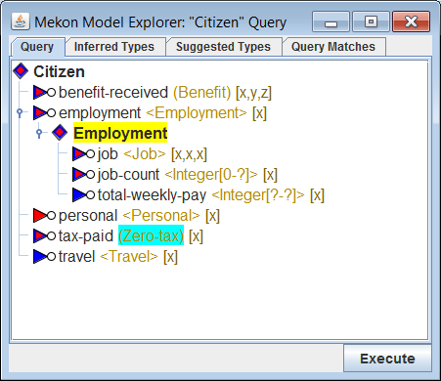
Actions:
Instantiate Citizen query
Add a value to Employment slot
Discussion:
As in the corresponding assertion example (see earlier), the tax-paid slot has its value-type updated to Zero-tax, since the fact that no jobs have been specified leads to the inference (via the closed world assumption for that slot) that the citizen is unemployed and hence does not pay tax
However, unlike in the assertion example, values are not inferred for either the tax-paid or benefit-received slots. This is similar to the case discussed in the last slide, only here the entity responsible for the inference/non-inference is the generic EKS-related reasoning access mechanism, rather than the OM

Slide 59
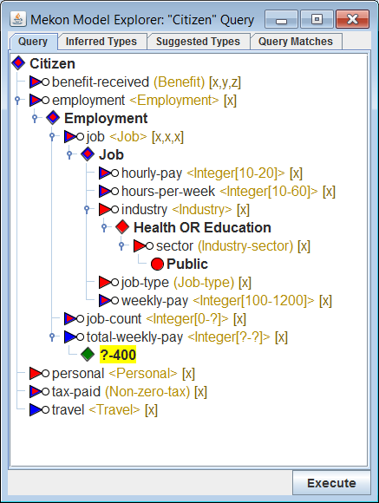
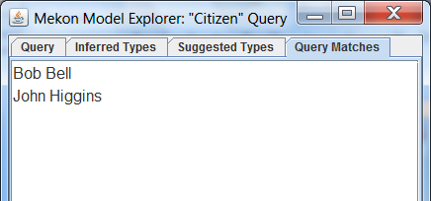
1
2
Actions:
Populate IS with variety of Citizen assertions, including values for variety of different-typed slots, at various levels of nesting
Construct Citizen query that will match sub-set of stored assertions
Click “Execute” button
Discussion:
The “Query Matches” tab, which is now displayed, contains all matches for your query, as found by the relevant IM plug-in (i.e. the MEKON-OWL IM plug-in, in this case)

Slide 60
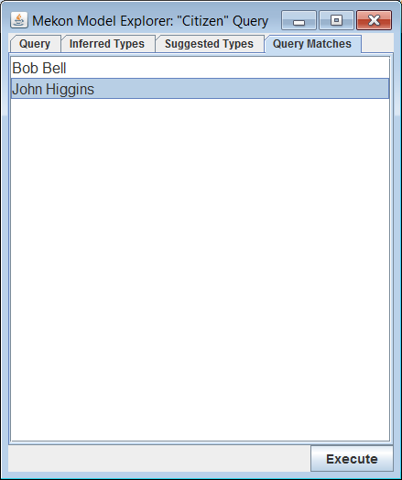
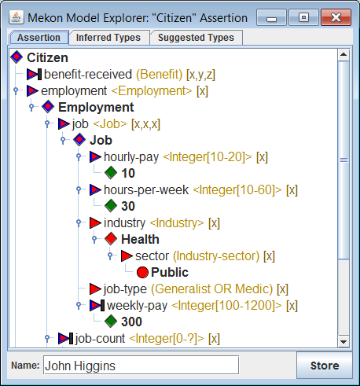
Actions:
Select items from the “Query Matches” list to display relevant details in an assertion window (wherein it is now possible to edit and re-store the assertions, if required)
Construct and execute various queries, checking results against expectations

Slide 61
Appendix: Loading Demo Model into Model Explorer

Slide 62
Using Mekon project Build Facilities
Ensure that all relevant code/resources are checked out from Mekon project SVN
Invoke ANT build script:
Ensure that ANT is installed on your machine
Go to top-level folder of check-out
Type:
> ant hobo-demo
Run Model Explorer:
Go to “build” directory, created by build script:
Invoke relevant script, either:
mekon-demo.bat/sh
hobo-demo.bat/sh

Slide 63
Using Your Own Build Facilities
Ensure that:
All relevant code/resources are checked out from Mekon project SVN
All code from all sub-projects is built
All code from “demo” folder is built
The “demo/resource” folder is on your runtime class-path (or preferably a copy of it)
Invoke main method on class for relevant version of Model Explorer:
...mekon.gui.MekonModelExplorer
...hobo.gui.HoboModelExplorer

